Slide 1
Lab 7: DEMS AND TIN
http://www.worldpop.org.uk/data/summary/?contselect=Africa&countselect=Algeria&typeselect=Population

Slide 2
Learning Objectives
Two types of surface models:
DEMS
Downloading and representing a DEM in 3D
A brief introduction to ArcScene, a powerful 3D visualization software within ArcGIS
TIN
Create a TIN from a set of LIDAR points
View the TIN in ArcScene

Slide 3
DEMS
Digital Elevation Models

Slide 4
Significance
Surface representation is critically important to many applications in GIS, including hydrologic analysis, terrain analysis, and floodplain analysis
There are many ways to represent surfaces. In this tutorial, we will focus on 3D extrusion and symbologies.

Slide 5
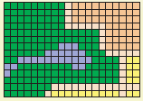
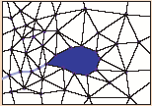
DEM vs. TIN
Digital Elevation Model (DEM):
Constructed by a matrix of rows and columns
Each cell in the matrix corresponds to x, y coordinates and contains a z (elevation) value.
Triangulated Irregular Network (TIN):
Constructed by a set of adjacent, non-overlapping triangles.
Computed from irregularly Spaced points with x, y coordinates and z (elevation) values.
Notes:
A TIN is a vector-based representation of the physical land surface or sea bottom, made up of irregularly distributed nodes and lines with three-dimensional coordinates (x, y, and z) that are arranged in a network of nonoverlapping triangles.

Slide 6
Data
The DEM in the data folder is from the Finger Lakes region of NY state.
DEM data can be downloaded from the USGS National Elevation Dataset and is in the Geographic Coordinate System.

Slide 7
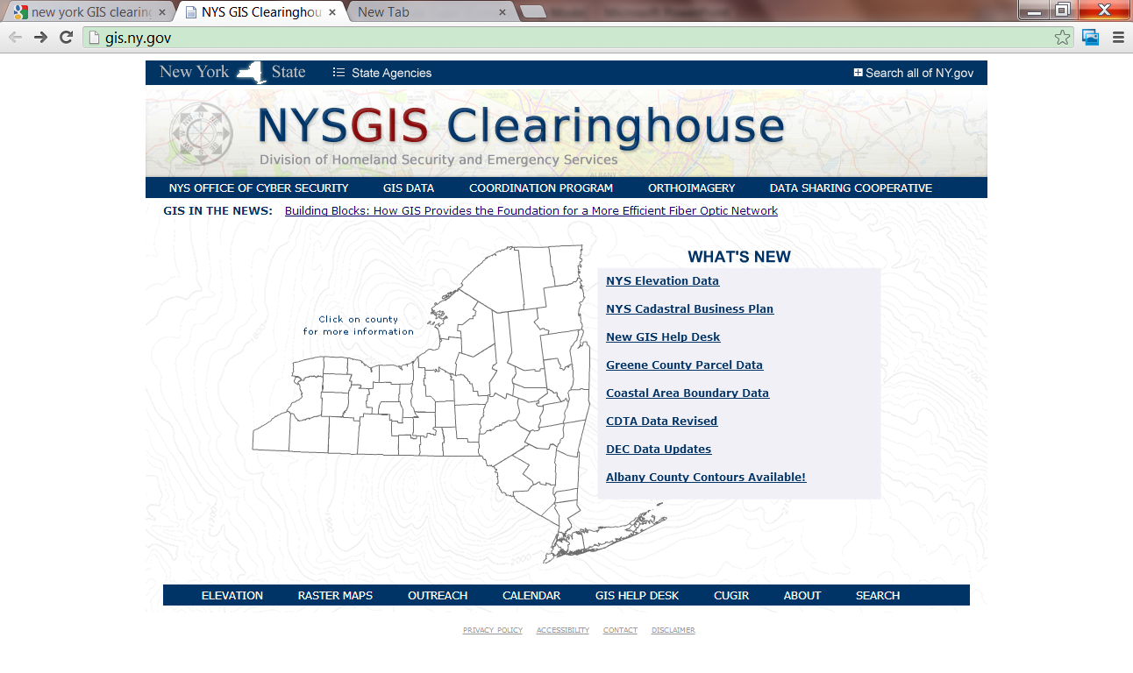
Download DEM
Go to the New York GIS clearing house website: http://gis.ny.gov
Click on the NYS Elevation Data link

Slide 8
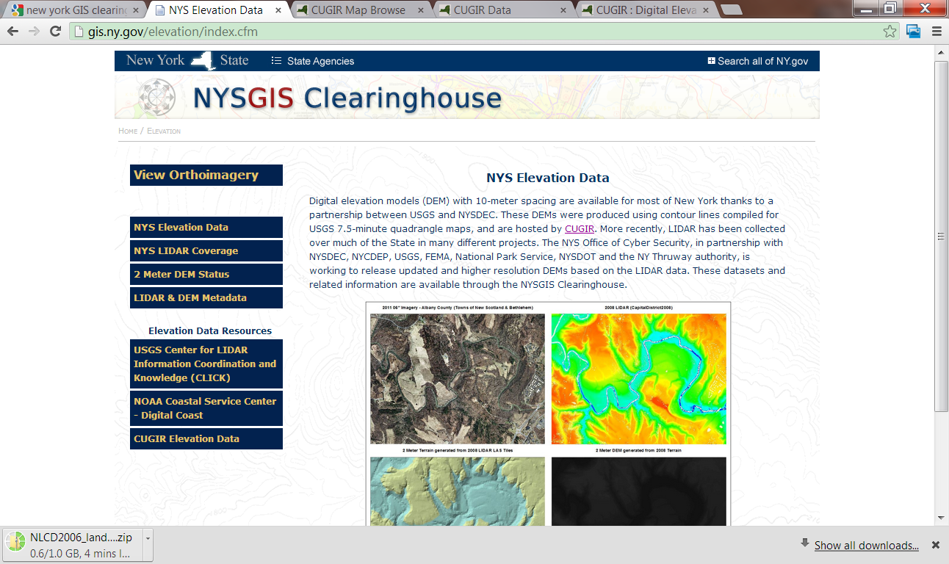
Click on the “CUGIR Elevation Data” link

Slide 9
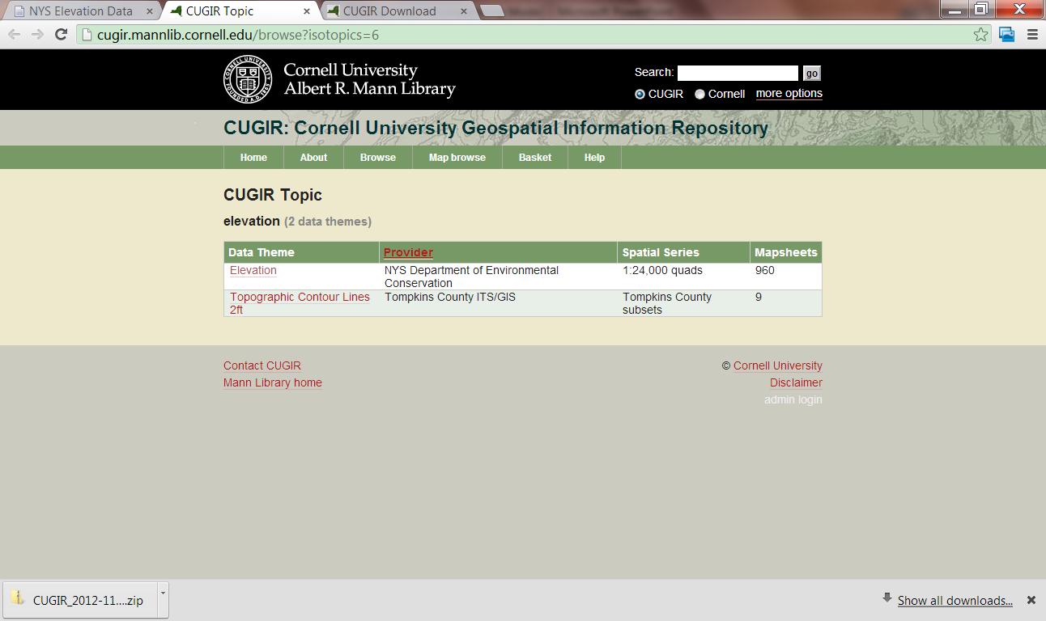
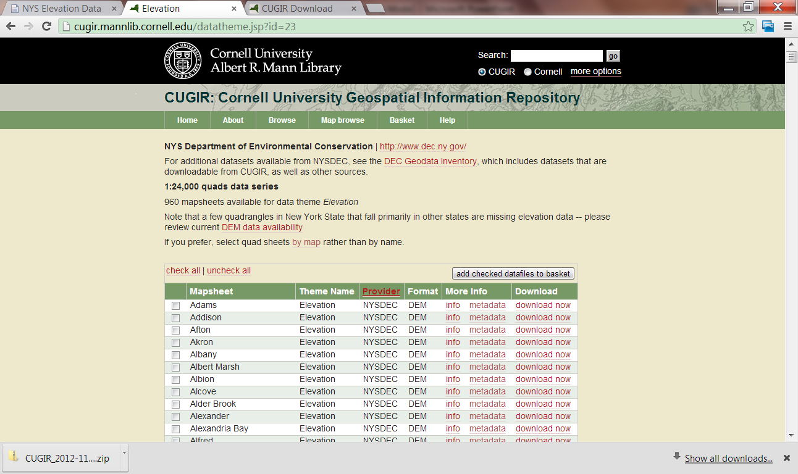
Click on the “Elevation” Link, this will navigate you to a list of dataset available for different cities in NY

Slide 10
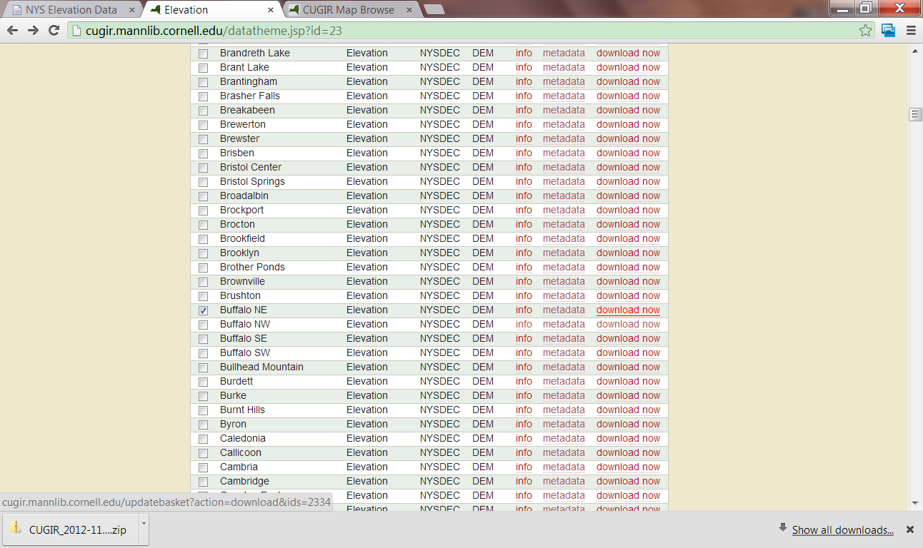
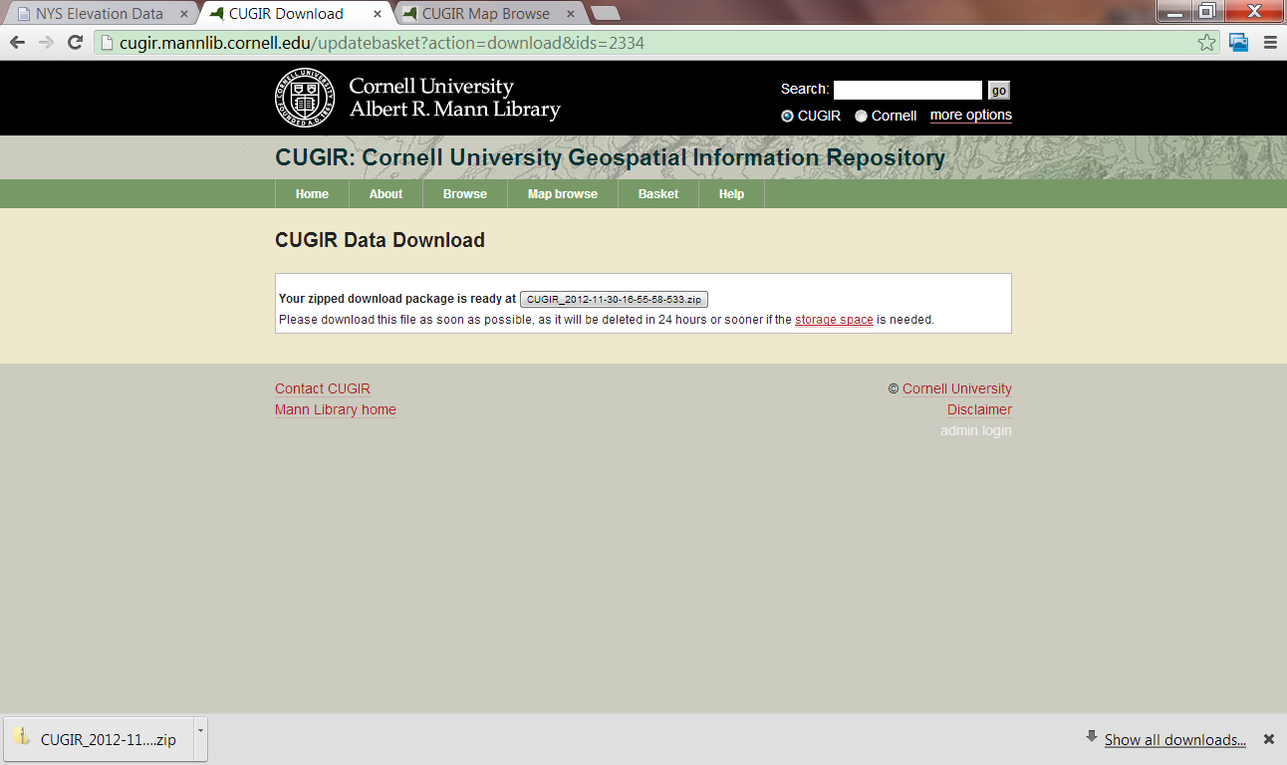
Use “Buffalo NE” as an example
Click the “download now” link, this will give you a download box

Slide 11
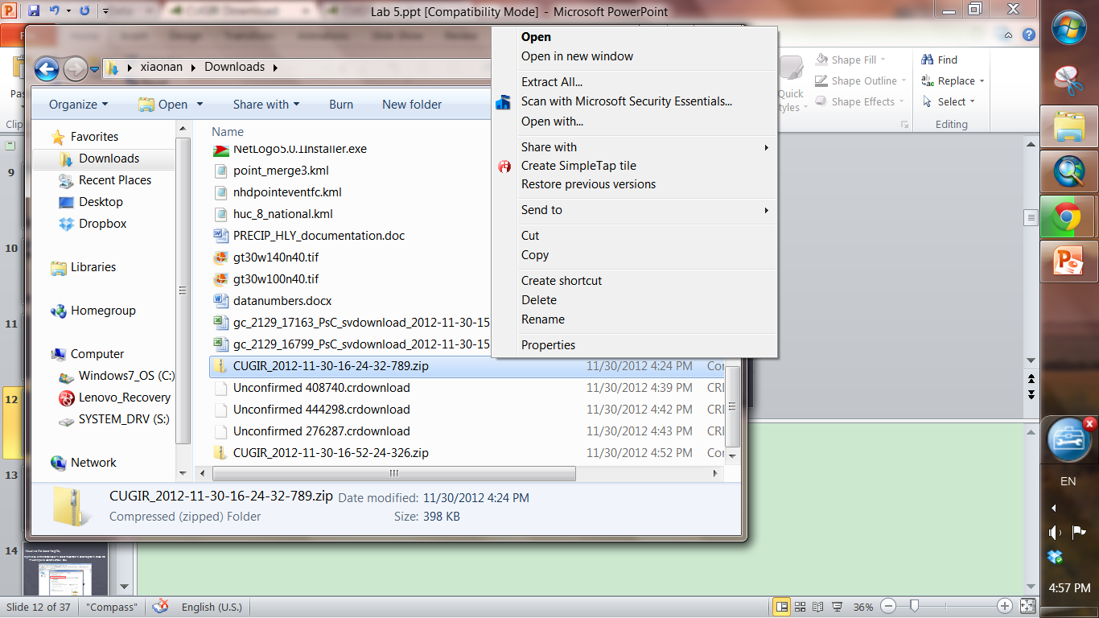
Not done yet, you need to extract DEM dataset from the compressed file

Slide 12
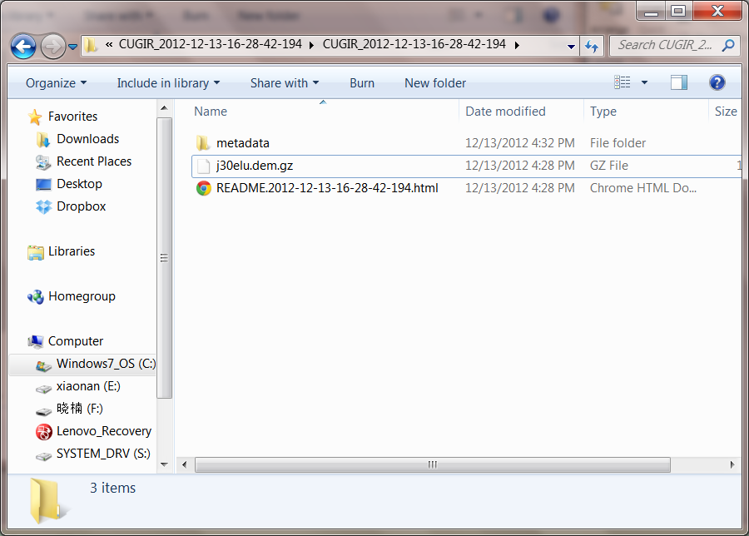
This will give you a folder, within the folder there’s a file with .dem.gz extension
Still not done yet
Need to extract the .dem.gz file for another time

Slide 13
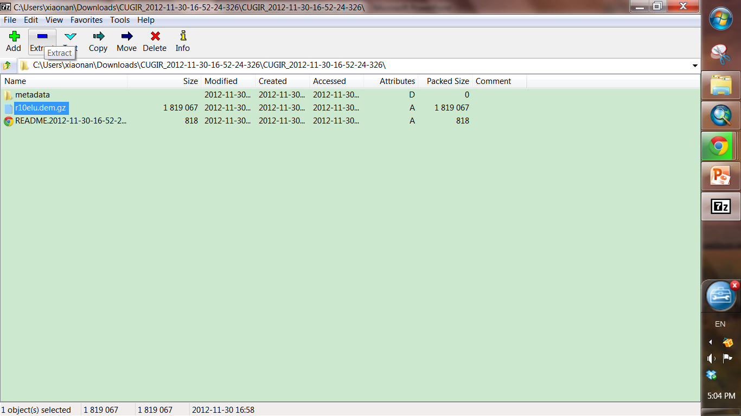
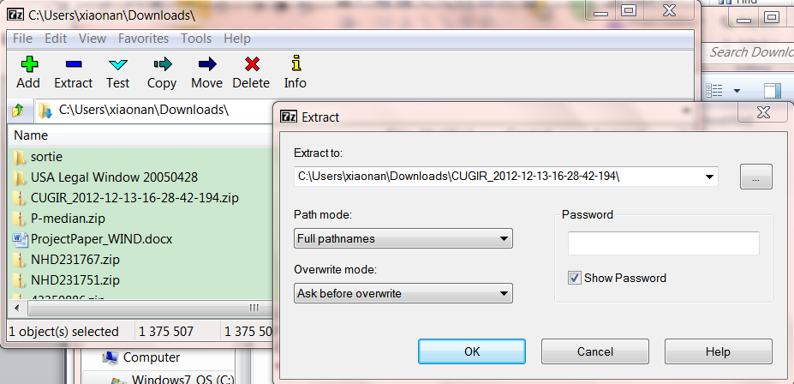
Need to take use of unzip tools
Start -> program -> 7-Zip -> 7 – Zip File Manager
Can also be downloaded from
Find the downloaded file and then click extract

Slide 14
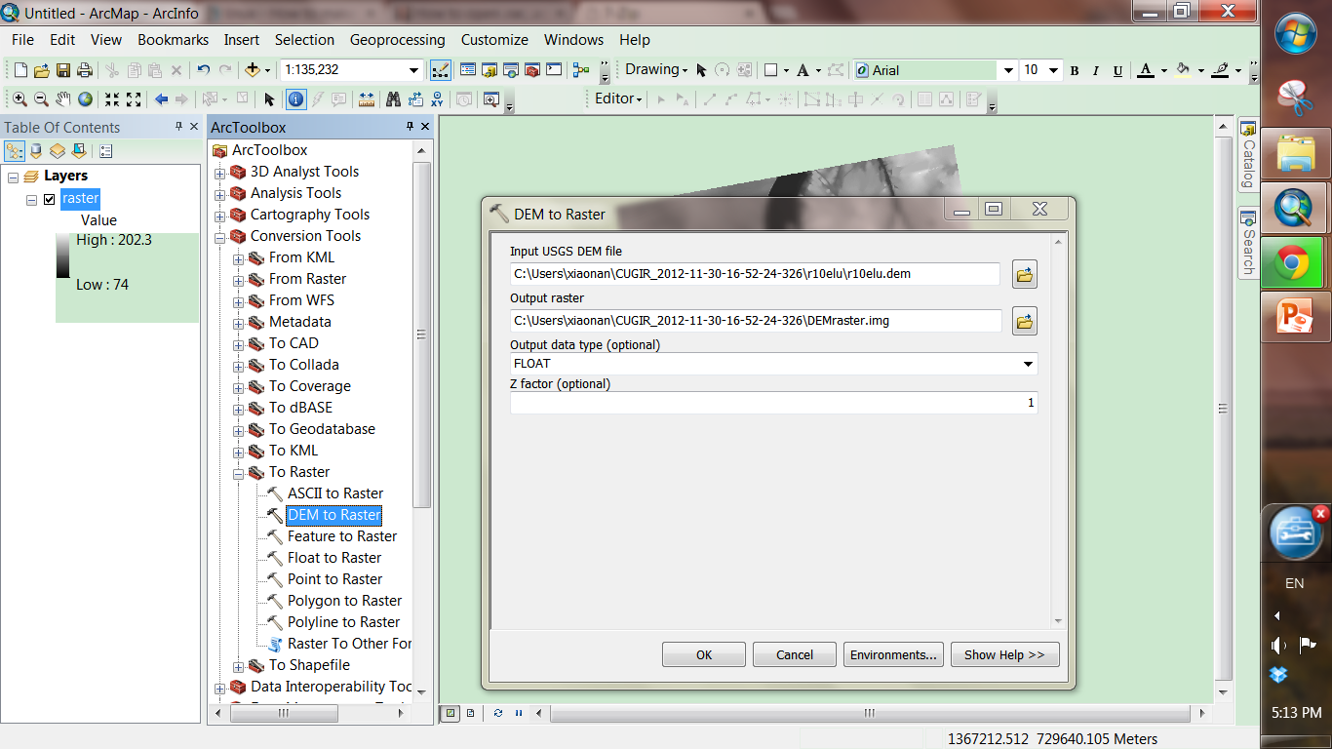
Launch ArcMap
ArcToolBox -> Conversion Tools -> To raster -> DEM to Raster

Slide 15
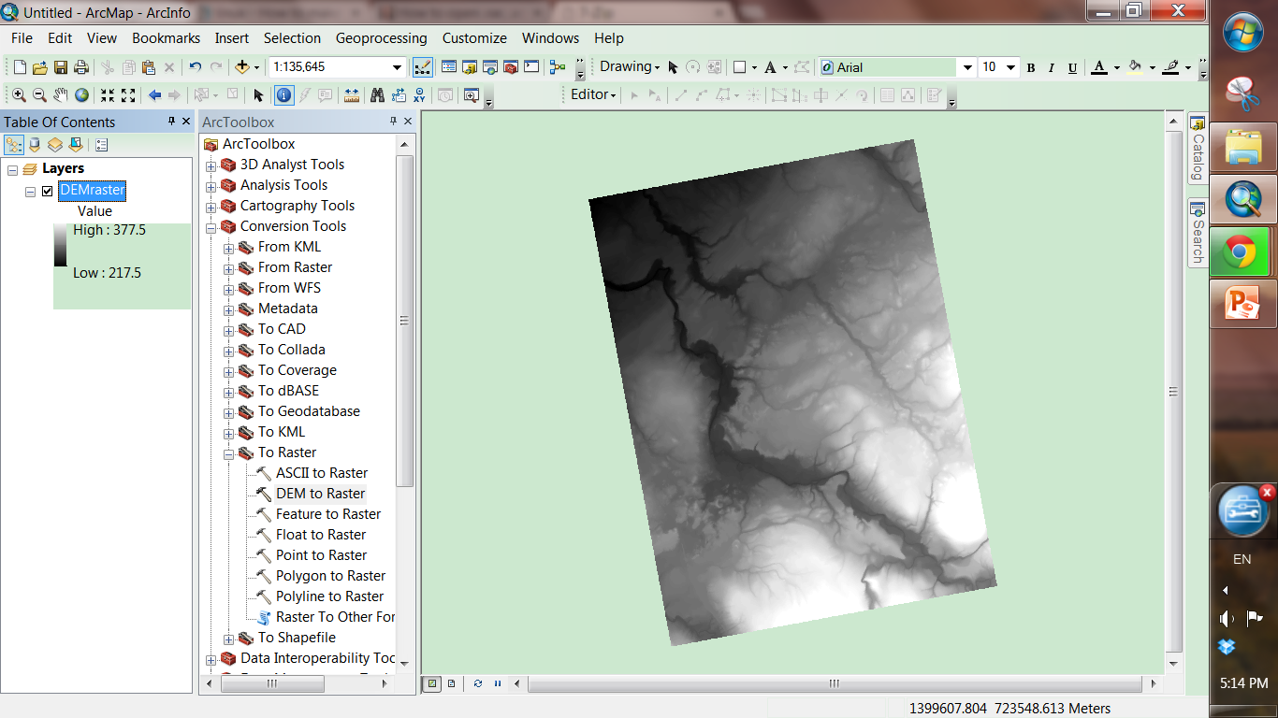
This is the DEM you made!

Slide 16
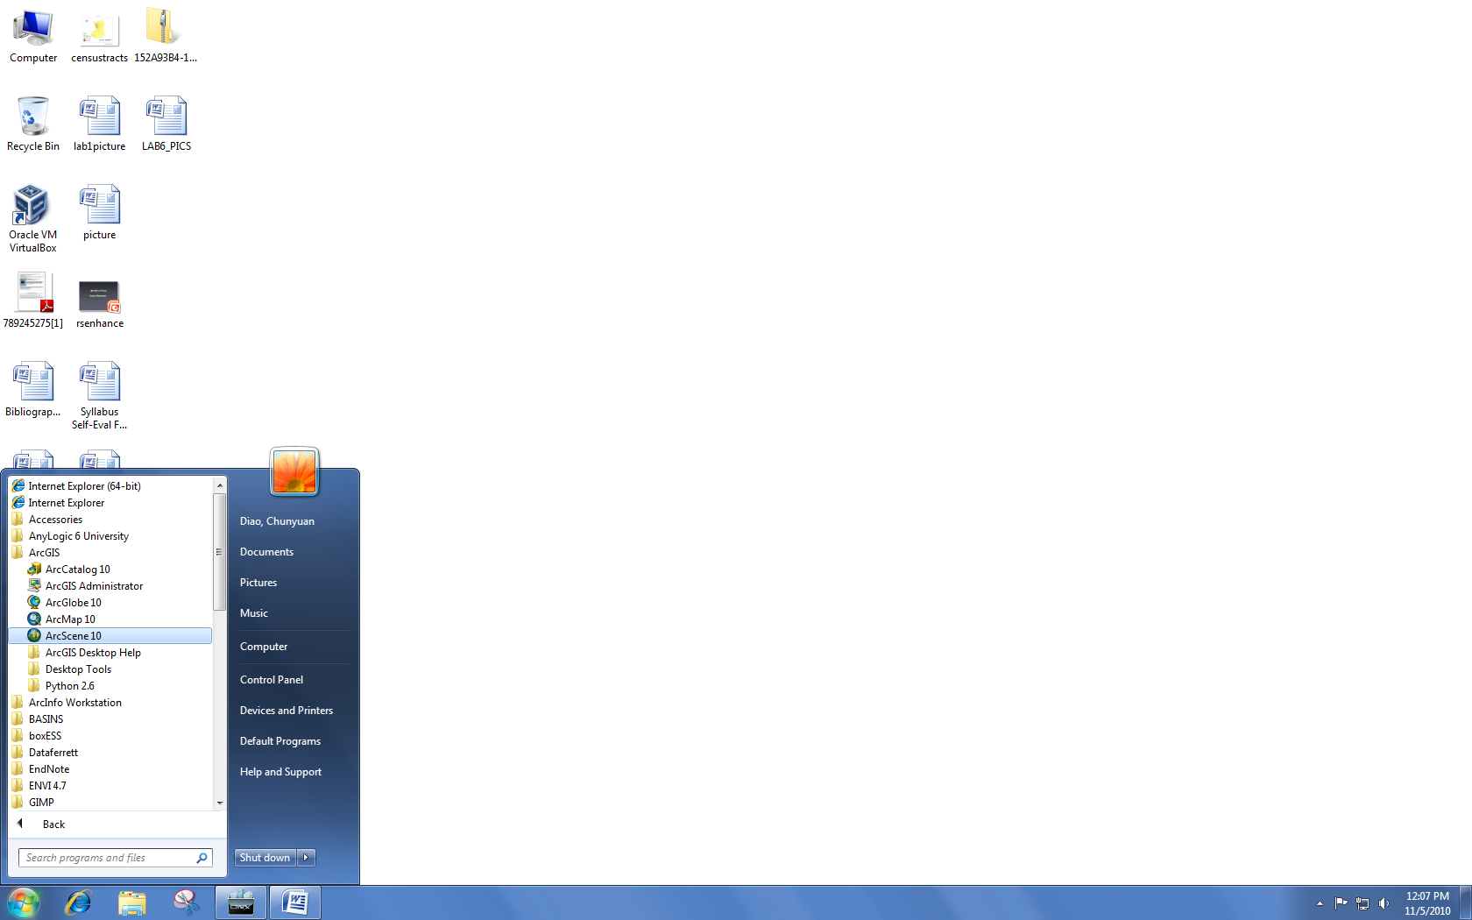
Opening ArcScene…
Go to Start → Programs → ArcGIS → ArcScene10.1

Slide 17
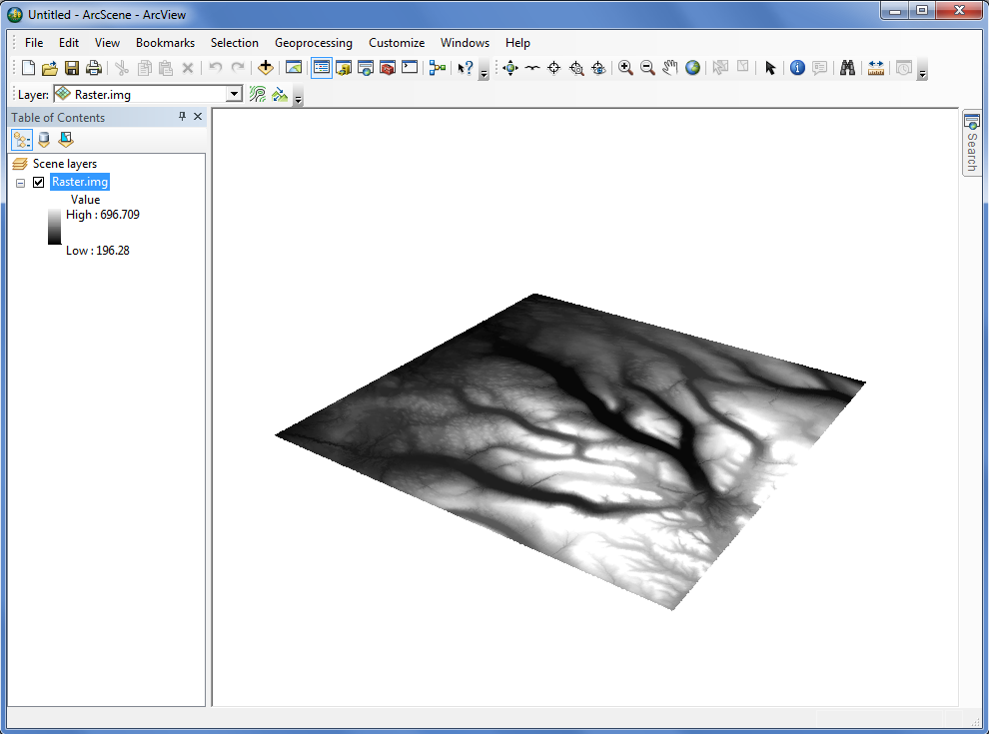
Add the DEM dataset “Finger_Lakes.img”.
Right now, we see that the differences in elevation are given by color differences only (darker colors for low elevations, brighter colors for high elevations).

Slide 18
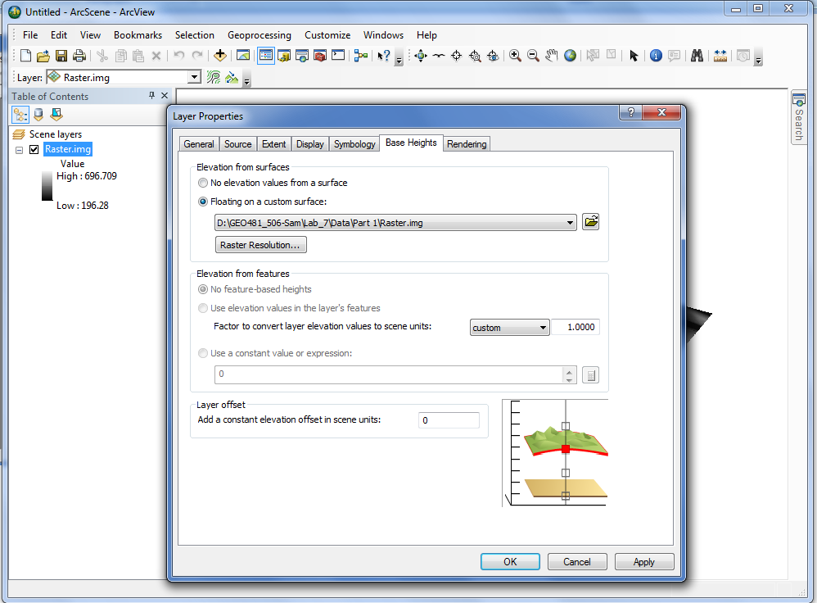
Visualize the base heights.
Right click on the Raster layer → select Properties → Base Heights → check the “Floating on a custom surface:” box.

Slide 19
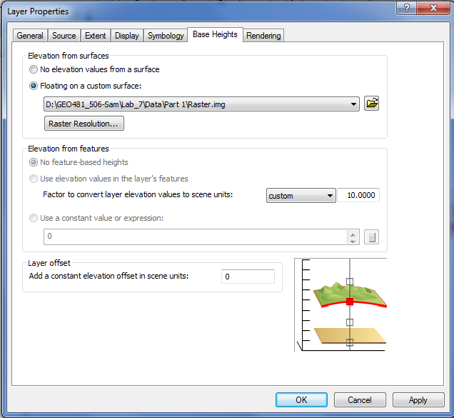
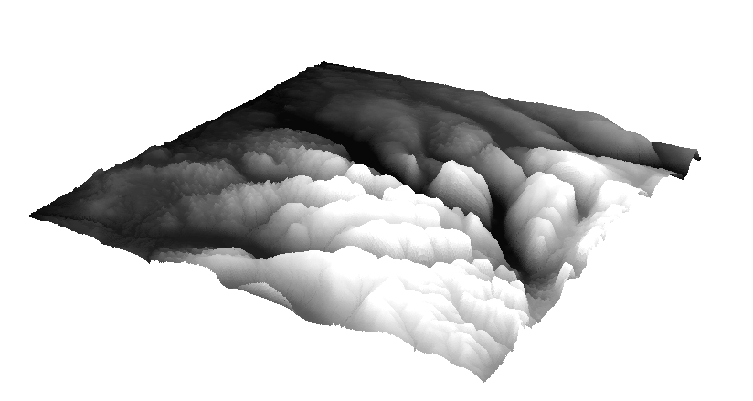
You can "exaggerate" or “multiply a constant to” the vertical dimension to bring out these features more clearly.
Under Elevation from features, change the value to exaggerate the vertical display.

Slide 20
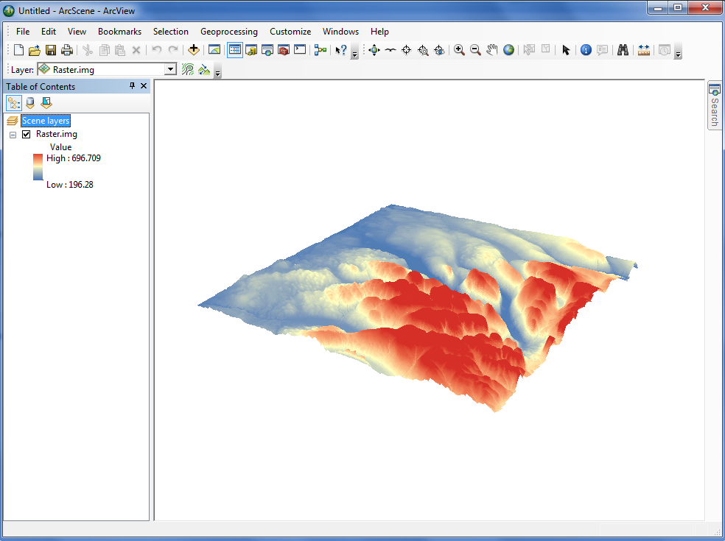
You can also change the symbology of the elevation. Click on the color ramp and choose a different one.

Slide 21
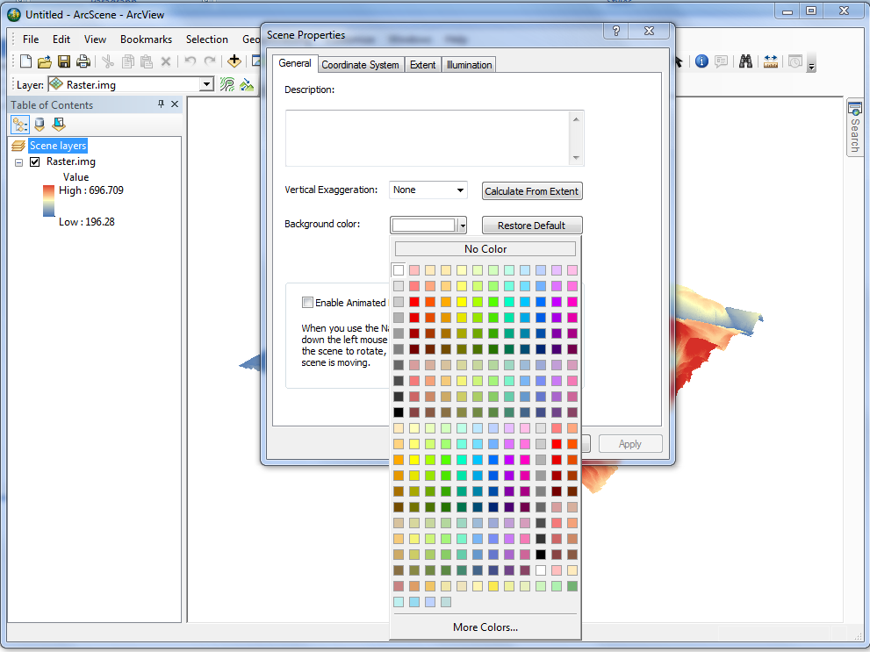
Now right click “Scene Layer” in the Table of Contents -> choose “Scene Properties”…
In the General tab, you can set the background color to highlight the 3D features.

Slide 22
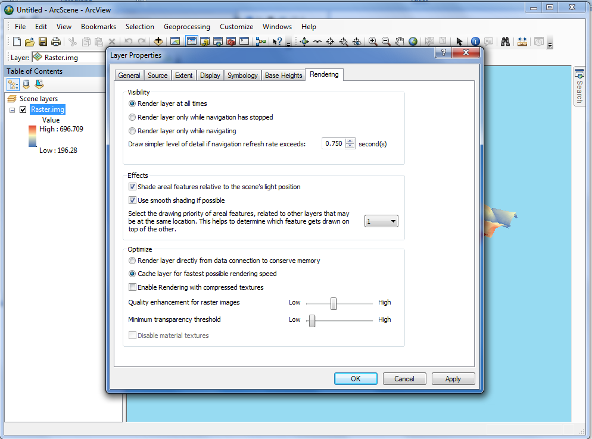
To enhance 3D effects, right click the Raster layer → Properties. In the Rendering Tab → check all of the “Effects” options.

Slide 23
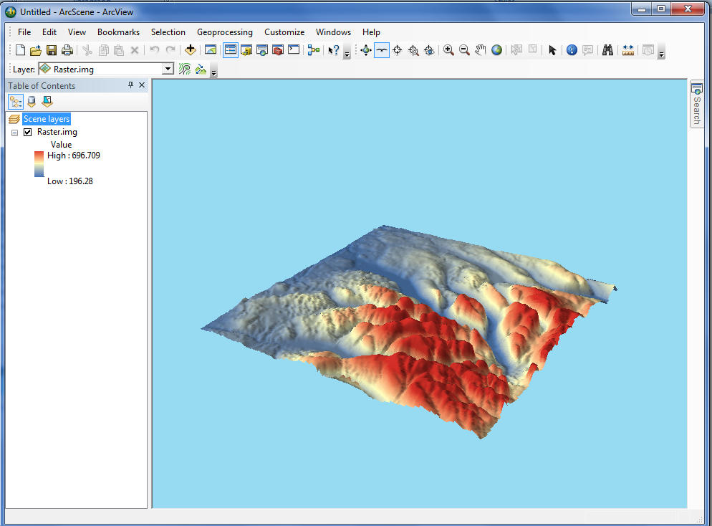
Let’s play around with the navigation and fly-through buttons. Have fun!

Slide 24
TIN
Triangulated Irregular Network

Slide 25
Significance
The combination of LIDAR data collection techniques and the TIN data model has been extremely effective.
TINs may provide a much more efficient means than raster of representing surfaces which have less relief.

Slide 26
Data
The included dataset is a sample LIDAR dataset. In actual fact, LIDAR datasets are hundreds of megabytes to multiple gigabytes so we will be using a “dummy” dataset.

Slide 27
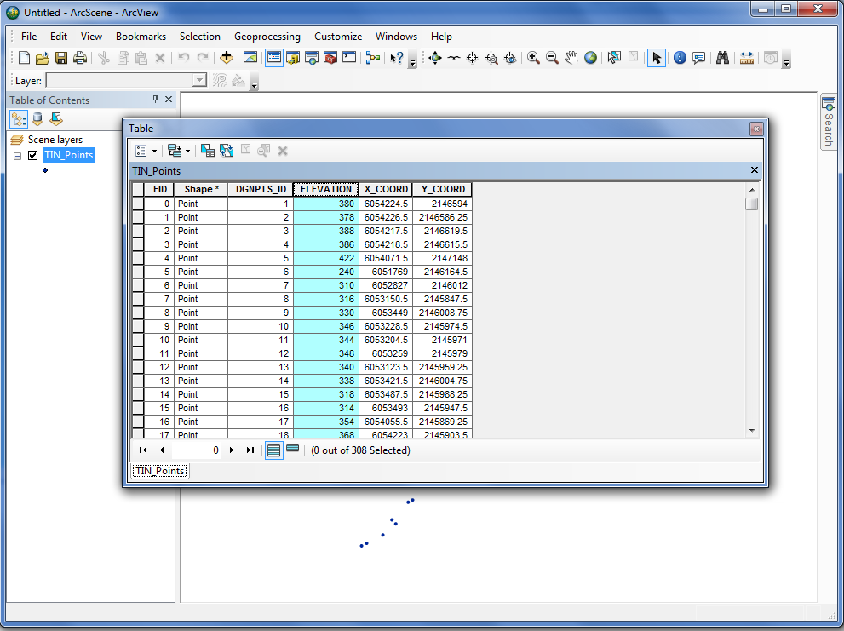
Add TIN_Points.shp to ArcScene.
Open the attribute table to see the elevation.

Slide 28
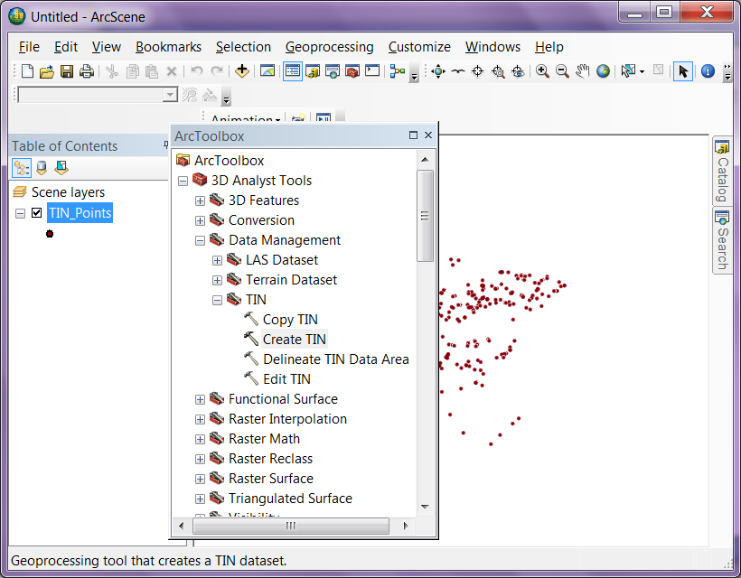
We will now create a TIN from these points.
Click Geoprocessing menu, choose ArcToolbox → choose 3D Analyst Tools → Data Management → TIN → Create TIN

Slide 29
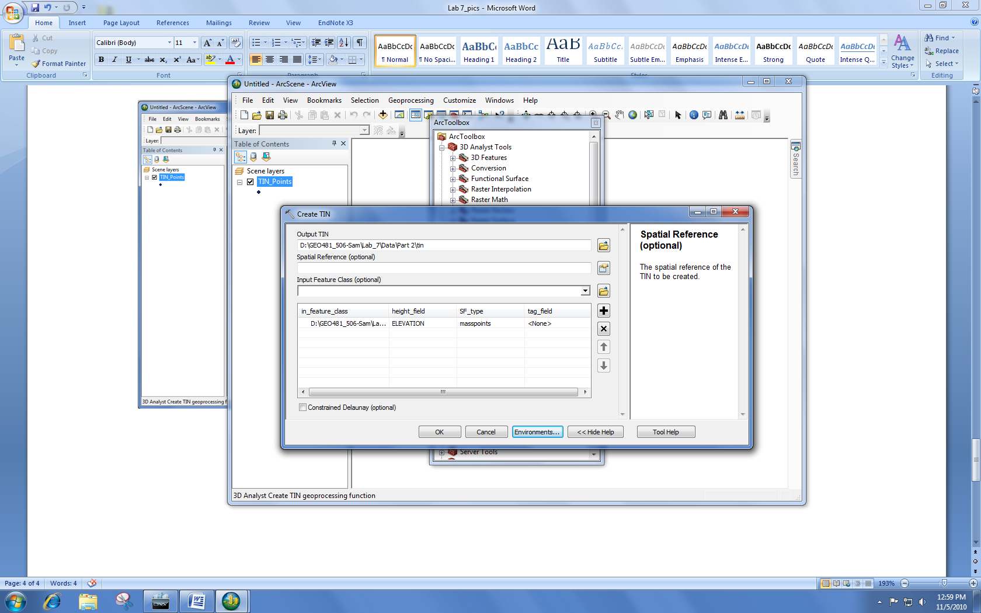
Name the Output.
Under ‘Output TIN’, browse to your personal folder and name it ‘tin’, under ‘Input Feature Class (optional)’, choose TIN_Points.shp, click OK.

Slide 30
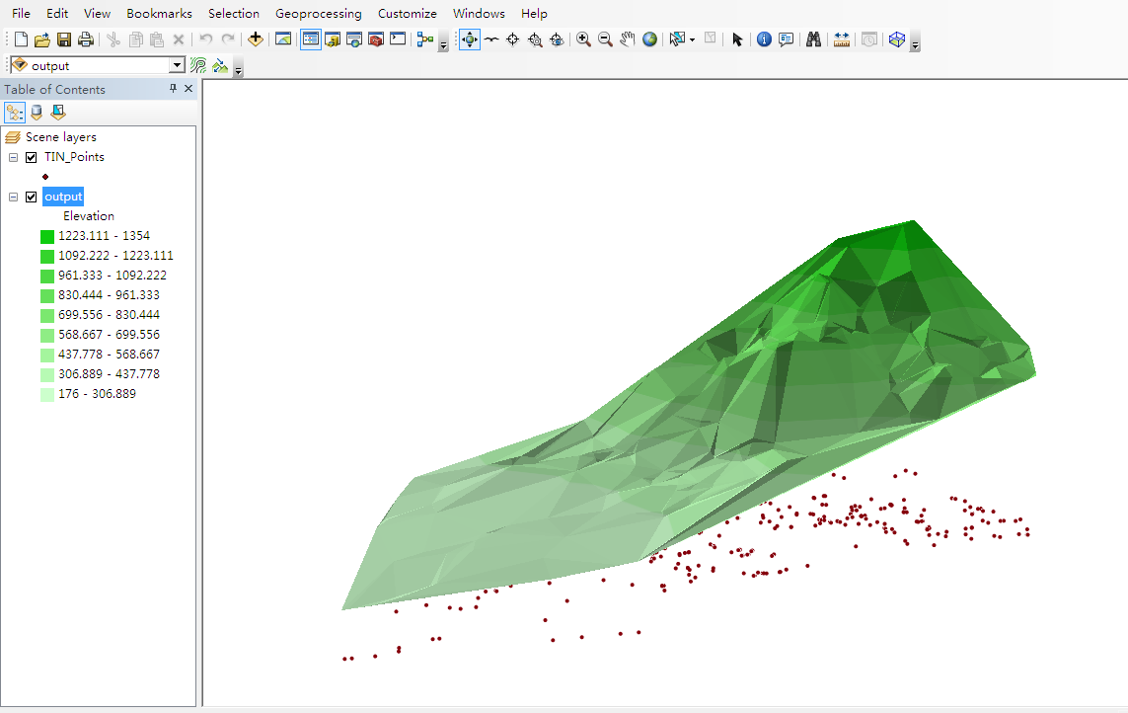
Display the TIN. Right click the TIN layer → Properties → Base heights → check “Floating on a custom surface:.”
Under “Elevation from features”, change this value to exaggerate elevation.

Slide 31
Practice Questions
Which color ramps do you think are effective for showing elevation? Which are ineffective?
What are some aspects of the landscape, you can see more clearly in 3D than in 2D with a symbology?
How does the TIN representation differ from a DEM?
In what situations would a DEM be better and in what situations might a TIN be better?

